Slide 1
ABSTRACT
Virtual desktop assistant is an awesome thing. If you want your machine to run on your command like Jarvis did for Tony. Yes it is possible. It is possible using Python. Python offers a good major library so that we can use it for making a virtual assistant.
Virtual Assistants are software programs that help you ease your everyday tasks, such as showing weather reports, creating reminders, making shopping lists, etc. They can take commands via text (online chatbots). followed by the command. We have so many virtual assistants, such as Apple’s Siri,
Amazon’s Alexa and Microsoft’s Cortana

Slide 2
Libraries
NumPy:
NumPy can be used to perform a wide variety of mathematical operations on arrays. It adds powerful data structures to Python that guarantee efficient calculations with arrays and matrices and it supplies an enormous library of high-level mathematical functions that operate on these arrays and matrices.
NeuralIntents:
Neural Intents is the self created library to help in specific domain. We used neural intents to help us in generic assistant basic tasks.

Slide 3
Libraries
Pandas_DataReader:
Pandas Datareader is a Python package that allows us to create a pandas DataFrame object by using various data sources from the internet. It is popularly used for working with realtime stock price datasets
Nltk:
NLTK is a leading platform for building Python programs to work with human language data. It provides easy-to-use interfaces to over 50 corpora and lexical resources. Natural language processing (NLP) is a field that focuses on making natural human language usable by computer programs. NLTK, or Natural Language Toolkit, is a Python package that you can use for NLP. A lot of the data that you could be analyzing is unstructured data and contains human-readable text.

Slide 4
Libraries
TensorFlow:
TensorFlow provides a collection of workflows to develop and train models using Python or JavaScript, and to easily deploy in the cloud, on-prem, in the browser, or on-device no matter what language you use. The tf. data API enables you to build complex input pipelines from simple, reusable pieces.
JSON:
JavaScript Object Notation (JSON) is a standardized format commonly used to transfer data as text that can be sent over a network. It's used by lots of APIs and Databases, and it's easy for both humans and machines to read. JSON represents objects as name/value pairs, just like a Python dictionary.

Slide 5
CODE EXPLANATION
Main.py
Main operations are performed in main.py file, we have first
imported all the recquired libraries such as sys, json, neuralintents
and datareader e.t.c. Then we have defined the functions which
we want to perform some of those functions are on next slide

Slide 6
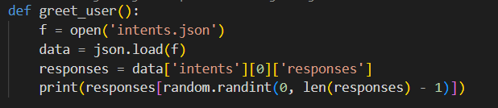
CODE EXPLANATION
greet_user:
Welcomes the user in the program and wishes the user

Slide 7
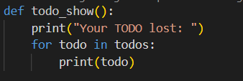
CODE EXPLANATION
todo_show:
It shows all the todos saved in memmory by the user so that user remains updated by the todos

Slide 8

CODE EXPLANATION
todo_Add:
Helps to add list of todos user wants to perform in future

Slide 9
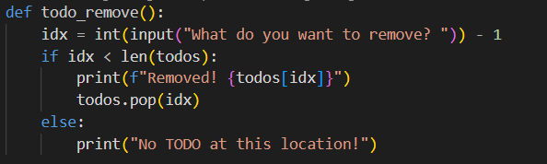
CODE EXPLANATION
todo_remove:
If the user has completed some todos or dont want them in the list then user can delete them

Slide 10
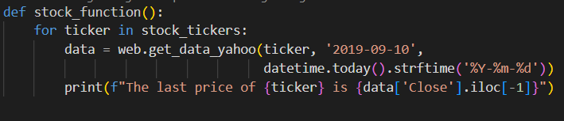
CODE EXPLANATION
stock_function:
Shows the information about stock their current rates and fluctuations happenings now a days.

Slide 11
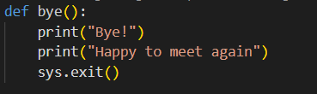
CODE EXPLANATION
bye:
It tells bye and exits the program

Slide 12
CONCLUSION
The AI used is based on NLP algorithm.
Used multiple libraries including NLTK, Neuralintents, Tensor Flow, Pandas Data reader, json,
date time and random
Included intents.json which contains most of the questions and their answers

Slide 13
THANK YOU

